Slide 1

Nature – Health linkages
Hans Keune
BiodiverSanté
le Grand Hôpital de Charleroi et Gembloux Agro-Bio Tech
Charleroi May 27th 2016

Slide 2
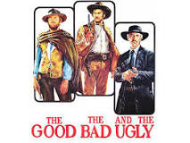
1. Biodiversity and health
  The Good
  The bad
  The opportunities
Opportunities

Slide 3

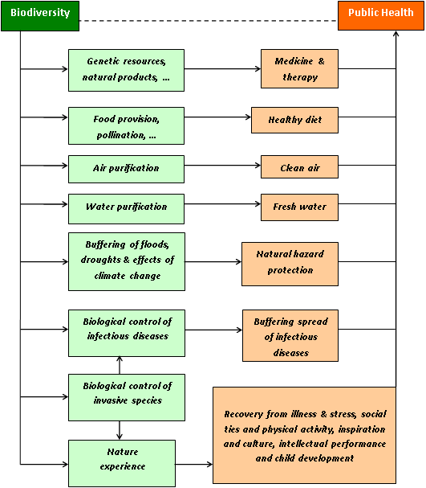
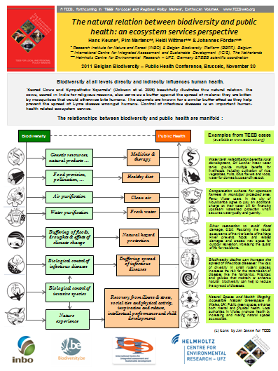
1a.
The good

Slide 4
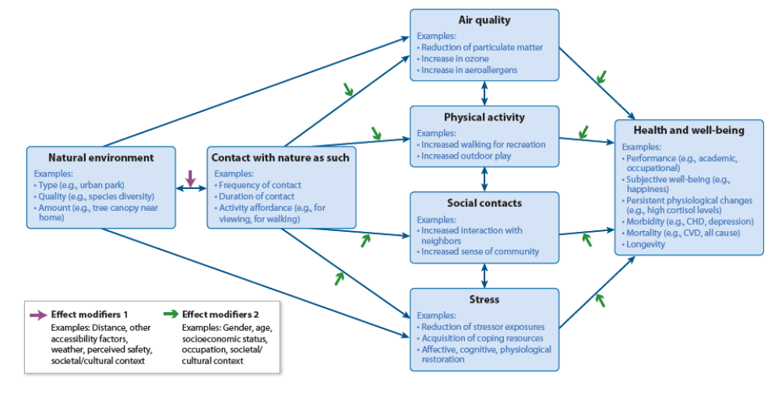
…
Hartig et al. 2014

Slide 5
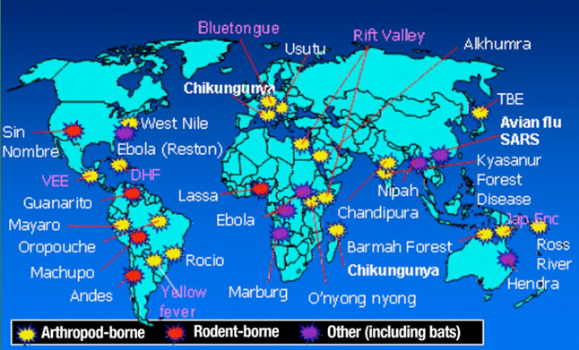
1b. The bad
Taylor et al., 2001 Phil. Trans. R. Soc. Lond.
>70% of emerging pathogens in humans have been passed from animals

Slide 6

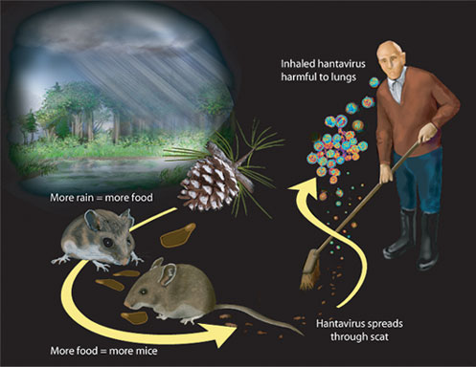

Slide 7
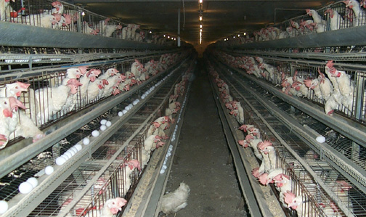
Predisposing factors:
Intensive animal production

Slide 8
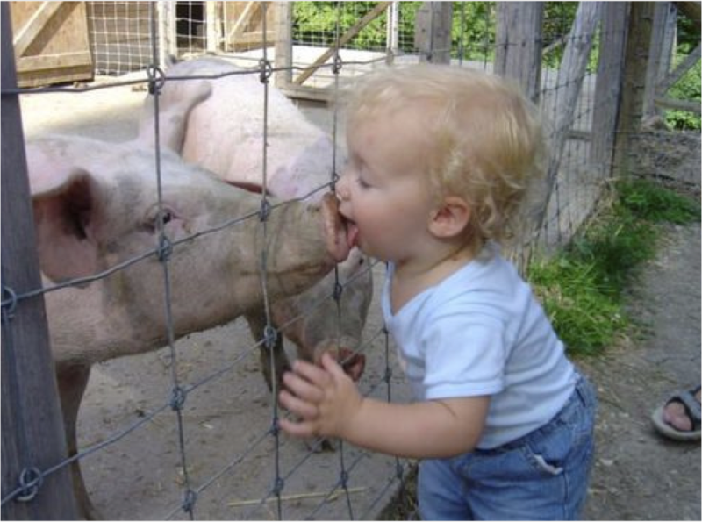

Slide 9
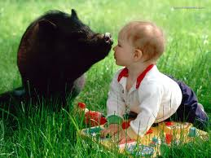
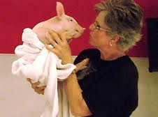
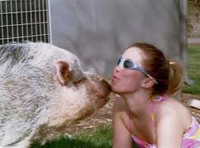
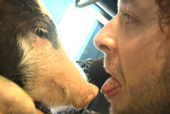
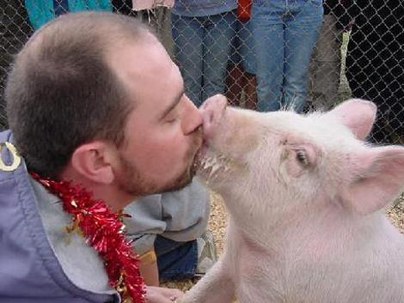
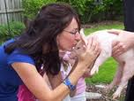
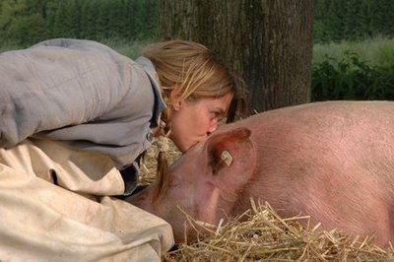
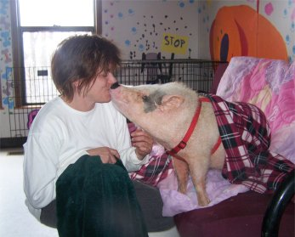
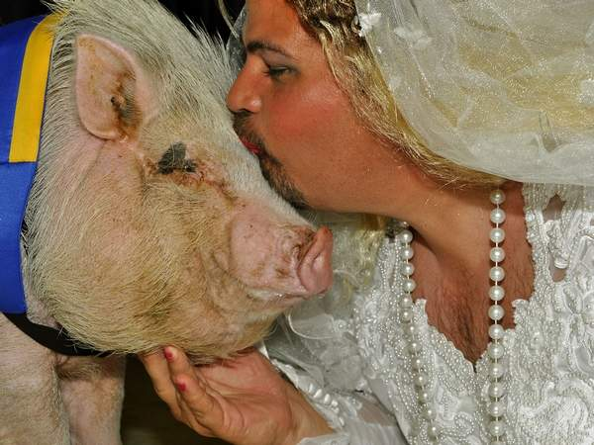

Slide 10
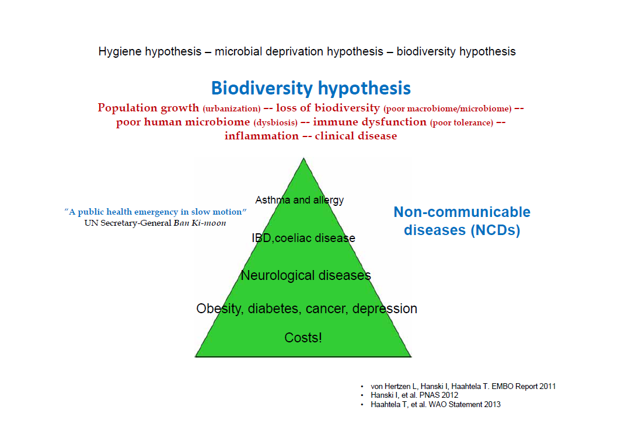
Good and bad

Slide 11
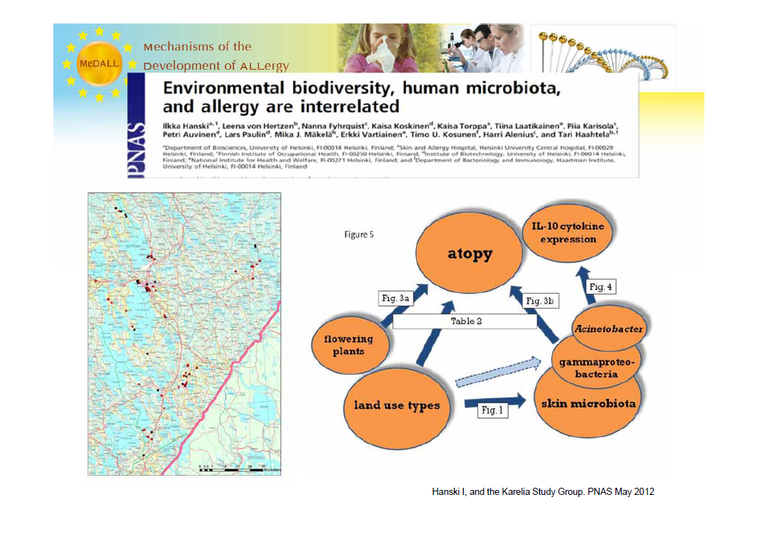
…

Slide 12
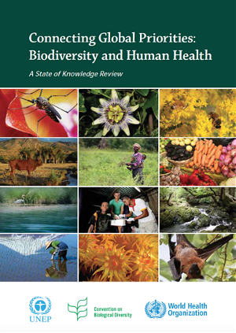
1c – The opportunities
CBD – WHO state of knowledge review
Officially launched at the 14th World Congress for Public Health held on 13th February 2015, in Kolkata, India.
Upon release of the full-length volume, the book will be the new flagship publication under the CBD joint work programme on biodiversity and health co-led with the World Health organization, in collaboration numerous international partners.
It will be an important source of information to support the implementation of the emerging post-2015 development agenda and sustainable development goals of the United Nations.

Slide 13
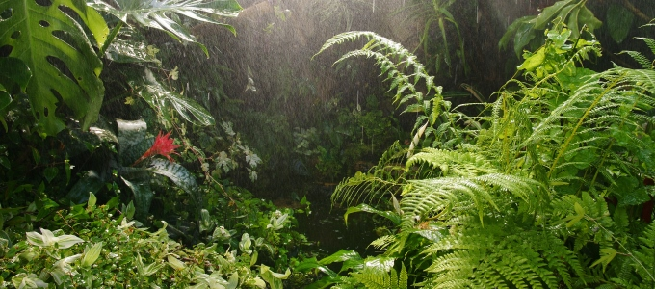
Biodiversity and health
  The report outlines the ways that the conservation and sustainable use of biodiversity has positive impacts on human health, including through impacts on water and air quality, nutrition, non-communicable and infectious diseases, and medicines, among others.
Opportunities
  Biodiversity plays a complex role in disease emergence, with benefits in some contexts and threats to human health in others. While areas of high biodiversity may, in some cases, contain a high number of potential pathogens and contribute to the spread of disease, in some contexts biodiversity may also serve as a protective factor for preventing or reducing exposure to infectious agents.

Slide 14
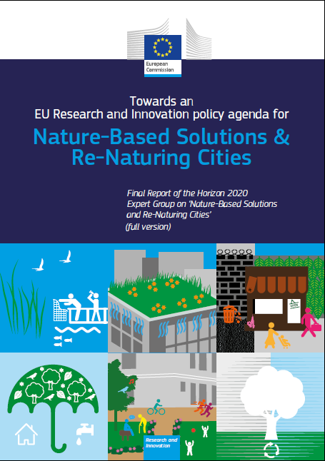
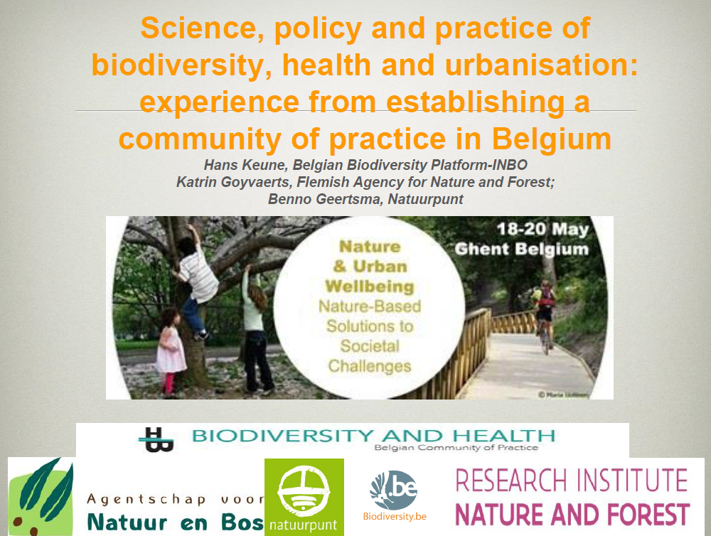
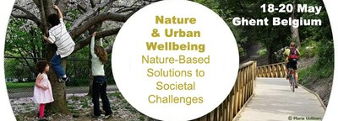
Nature based solutions EU
http://www.alter-net.info/outputs/conf-2015

Slide 15
2 Research/practice
EU
BE

Slide 16

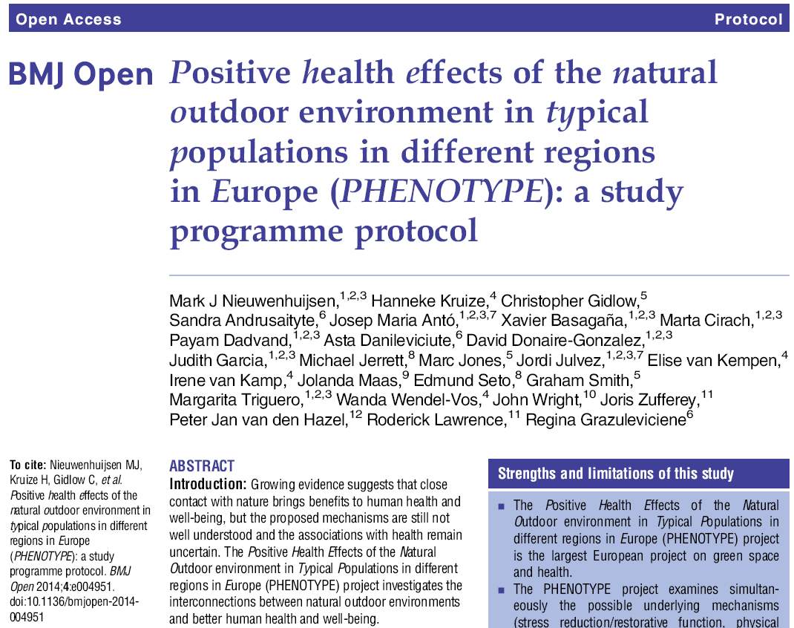
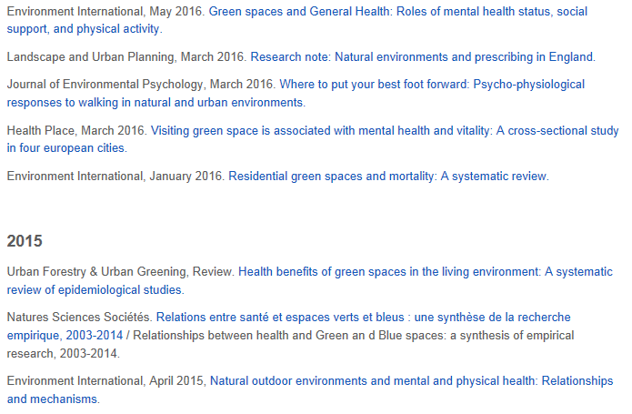
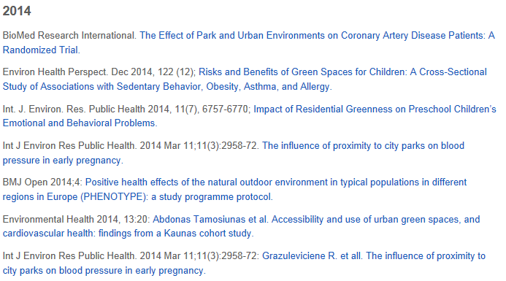

Positive health effects of the natural outdoor environment in typical populations of different regions in Europe
www.phenotype.eu

Slide 17





Health and Social Benefits of Nature and Biodiversity Protection
Patrick ten Brink, Senior Fellow and Head of Brussels Office, IEEP
with thanks for inputs by colleagues:
Konar Mutafoglu & Jean-Pierre Schweitzer (IEEP) and building on work of wider team
Europe’s urban health & equity challenge and the SDGs: Is there a nature-based solution? Session 7/1, 20th May 2015, 10.30am – 12.00pm
Alter-NET International Conference 2015: “Nature and Urban Wellbeing: Nature-Based Solutions to Societal Challenges” 18 - 20 May 2015, Ghent, Belgium

Slide 18
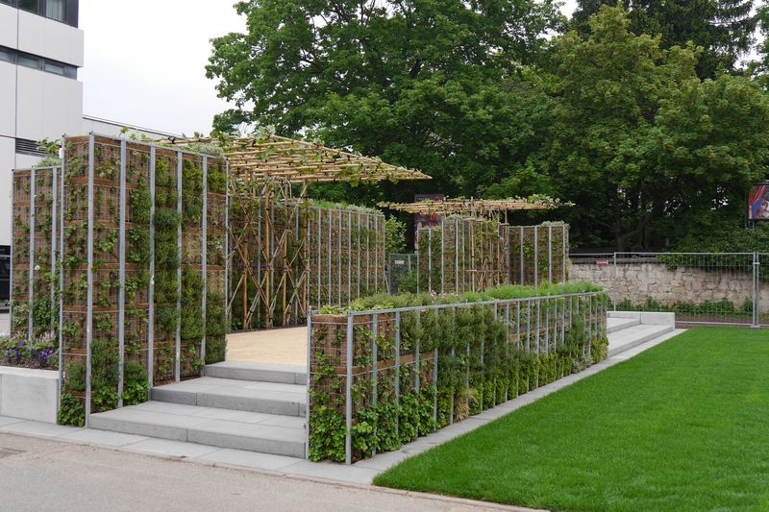
Improved climatic conditions – heat stress etc.
Green Roofs in Sheffield, UK
Like many cities across Europe, Sheffield, has developed strategies to encourage the installation of green roofs. Green roofs are an integral part of the Sheffield City Council Development Framework.
Sheffield today has the highest number of green roofs in a UK city (except for London)
Green roofs are multifunctional (urban cooling, noise reduction, air pollution mitigation, biodiversity)
Green Corridors and Waterfront in Lyon, France
Lyon has been severely impacted by the summer heatwave in 2003
A number of initiatives are coordinated to improve the urban heat island effect, including green corridors to provide cooling and green spaces along the Rhone river
These infrastructures are again multifunctional, offering climate and air quality benefits, but also new opportunities for recreation, healthy lifestyles and connecting previously separated neighbourhoods.
Green Room in Ludwigsburg, Germany
The Ludwigsburg region is expecting the number of days with extreme heat to double until 2100.
A research project is exploring new infrastructure types such as the “Green Room”.
The “Green Room” helps in cooling urban space, but also promotes biodiversity and social interaction.
© Region Stuttgart

Slide 19
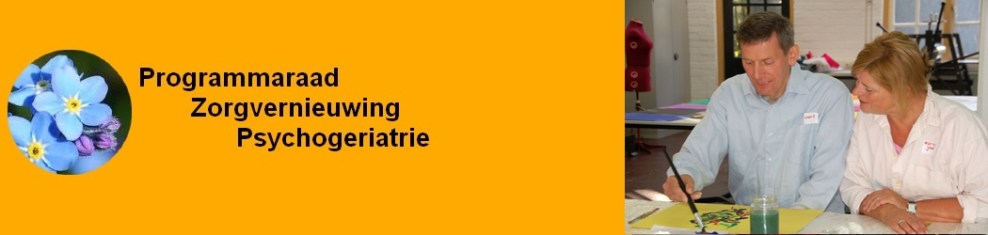
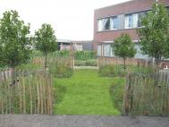
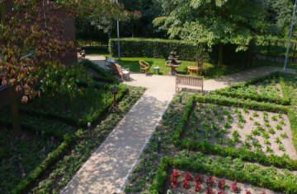
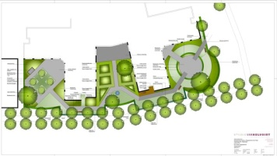
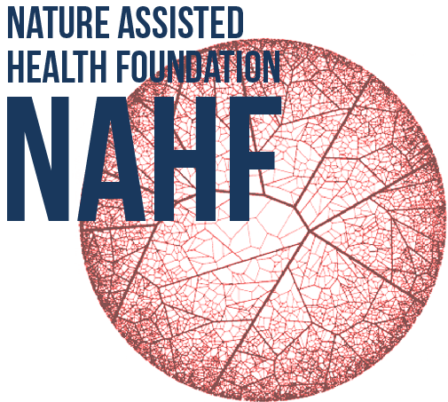
Nature Assisted Health for people with dementia and their caregivers
Number of people with dementia in the province of North Brabant number of care givers
2012 1 : 72 102.974
2020 1 : 57 133.418
2030 1 : 43 179.948
Dementia Gardens:
Improve quality of life of people suffering from dementia
Reduction of costs: less use of medicine, less need for care, reduce the burden for care givers and staff
business development: manual/training implementation
Thebe De Vloet, Oisterwijk
De Wever, Tilburg
Herbergier, Drunen

Slide 20
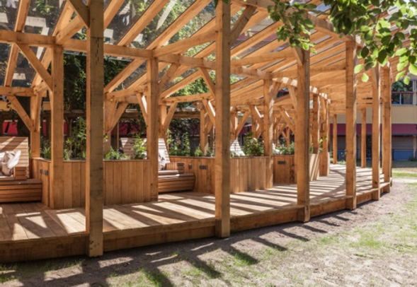
Chemotherapy in natural surroundings

Slide 21
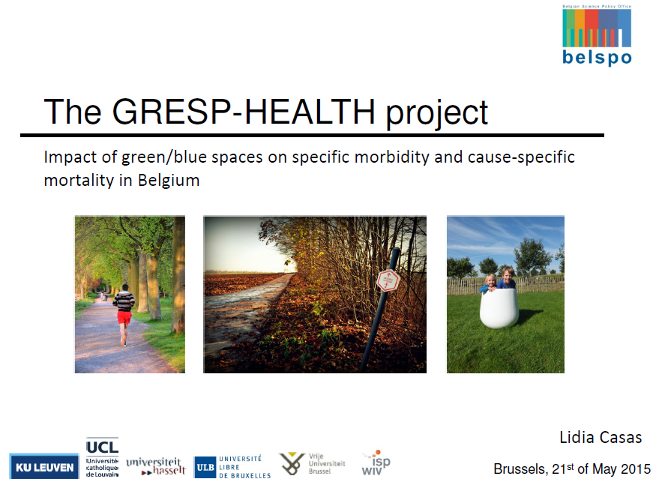
2b Research/practice Belgium
RESPIRIT project - Assessing spatio-temporal relationships between respiratory health and biodiversity using individual wearable technology
Project aims at exploring and understanding the spatial and temporal effects of plant diversity on respiratory health in general and allergic asthma and allergenic rhinitis specifically
Green light. Producing a researchdesign for policy- & practice oriented research on nature – health linkages, with special focus on vulnerable groups in the Province of Antwerp.
Collaboration Province of Antwerp (nature & well-being) & Universiteit of Antwerp (primary health care)
From october 2016

Slide 22

Science – policy – practice interface: http://biodiversity.be/health/
Registry of experts in science – policy practice: please join us: Katriina Kilpi (k.kilpi@biodiversity.be) (hans.keune@inbo.be)
Survey on OneHealth and other environment & health integrating frameworks: http://biodiversity.be/health/105

Slide 23
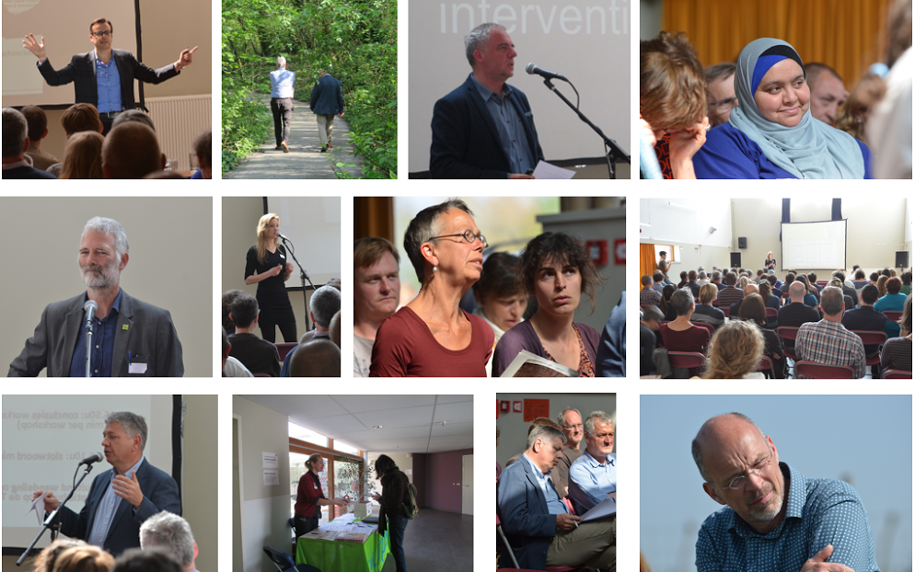
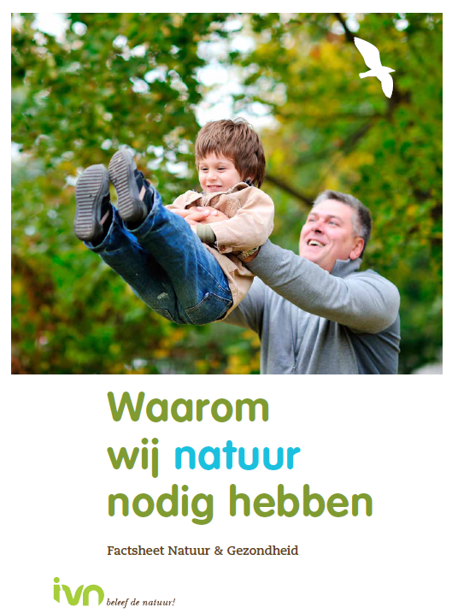
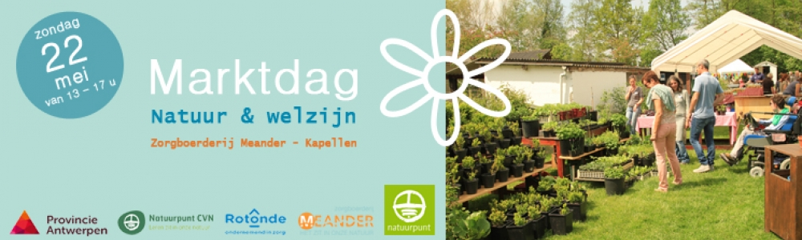
Natuurpunt

Slide 24
3. Challenges

Slide 25
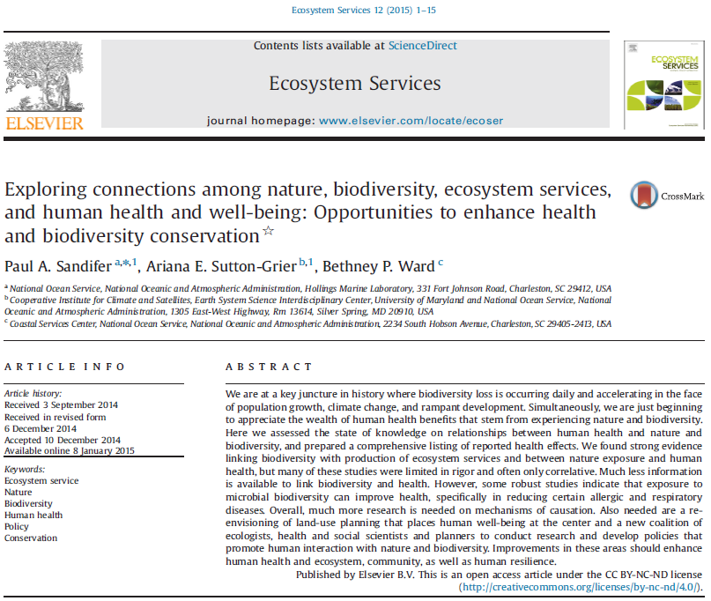
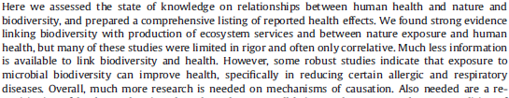
…

Slide 26
Evidence cultures
Pyramid of evidence. RCT = Randomized Controlled Trial; NRCT = Non-Randomized Controlled Trial. Van den Berg & Van den Berg (2015)

Slide 27
WHO – CBD state of knowledge 2015
Whilst some of these connections between health and living natural resources are well established – such as the value of wild species as sources of food and medicines – others are less well understood, and may be locally or regionally specific
The ways in which health status is affected by biodiversity and ecosystem services is (…) determined by the nature of specific social-ecological systems, including the degree and types of interactions between people or their communities and the natural environment. This points to the importance of social, economic and cultural factors in determining the strength and direction of linkages between health and biodiversity. This means that differentials in the ways in which some communities (including ILCs) or groups within wider society (e.g. women, people suffering from poverty) experience and interact with biodiversity and ecosystems may also result in differences in the influence of biodiversity and ecosystems on their health status, with the potential for group- or community-specific dependencies and risks

Slide 28
Research challenges - Hartig et al. 2014
First population-level experimental studies
Second, which types of nature are relatively effective for particular outcomes
Third, with specific regard to the stress pathway, much work remains to be done to rigorously assess theoretical claims regarding the components of experience that sustain attention restoration and stress recovery
Fourth, research on nature and health might gain from a health economics perspective.
Finally, variety between population subgroups in access to, use of, and responses to nature remains persistently underexplored.

Slide 29
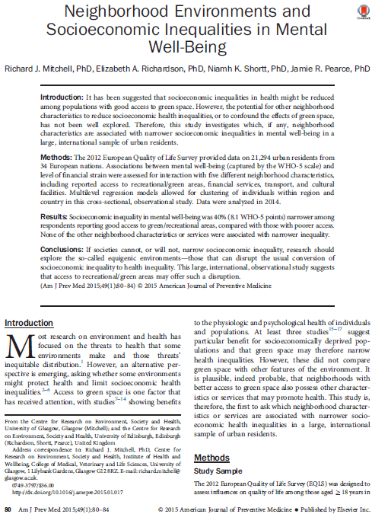
Based on data from a 2012 European Quality of Life Survey, Mitchell et al. (2015) found that ‘Socioeconomic inequality in mental well-being was 40% (...) narrower among respondents reporting good access to green/recreational areas, compared with those with poorer access’.
Where as ‘None of the other neighborhood characteristics or services were associated with narrower inequality’.
A conclusion might be that access to green/recreational areas may have a positive health equity effect

Slide 30
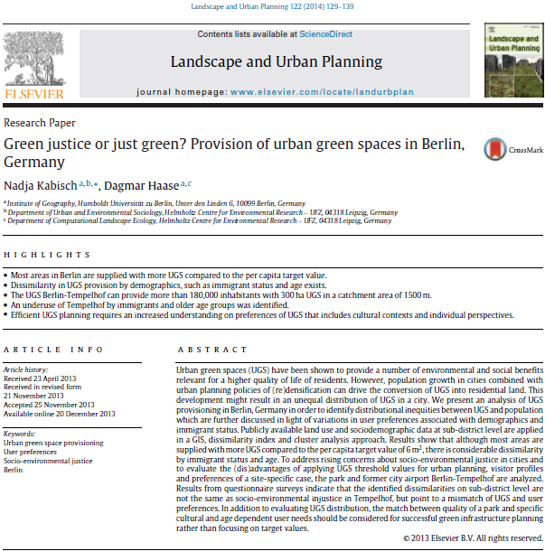
Green space in Berlin on average seems quite well accessible for the general population
But: ‘some of the inner city sub-districts with relatively high percentages of immigrants and high population density have disproportionate less access’.
When focussing on specific groups: immigrants and elderly people may have specific recreational needs, and especially for elderly, access may be difficult when transport infrastructure is poorly developed.
Importance to take into account the issue of quality of green space as well as access to green space in relation to different (potential) user groups, but to also involve these groups in the planning and decision process.

Slide 31
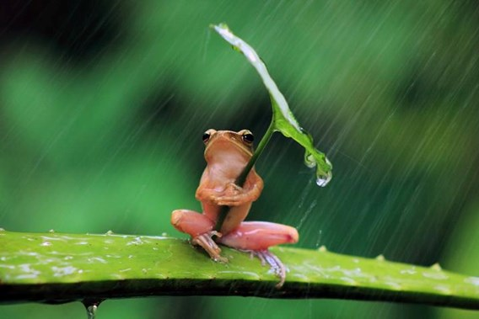
Thank you!
hans.keune@inbo.be

