Slide 1

High-Tech Startup Accelerator-Incubator
&
Seed Investment Fund
Startup incubation, ecosystems and urban farming?
Mr Simon ALEXANDRE
General Manager & Partner

Slide 2

Identifies, collects and develops business ideas based on
some disruptive technology that enables new products
to take worldwide leadership in niche markets
© The Faktory - Company Belinvest SA

Slide 3

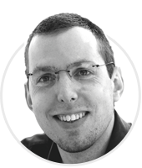
Executive Team
  Technology advisor - Yves JOSKIN
  Investment advisor - Jean-Pierre PIRONNET
  Market & financial analyst - Nicolas BIET
  Strategy & Sales Development advisor - Frédéric GARROY
  Sales & Marketing specialist - Imelda HERTONO
  Mobile Apps development team - Jonathan GROSS
Pierre L’HOEST
Founder & President
Simon ALEXANDRE
General Manager & Partner
  Founder & Former CEO of EVS - Broadcast (Degree in Architecture)
Former CEO of CETIC - ICT Applied R&D (Degree in History and Computer Sciences)
© The Faktory - Company Belinvest SA

Slide 4


Targeted technologies
Any disruptive technology in ICT
with a special focus on Internet of Things
© The Faktory - Company Belinvest SA

Slide 5
Three step approach
1
2
3
Initial analysis of the idea with startup founders and definition of a collaboration framework agreement
Market exploratory phase from 6 to 18 months based on a Minimum Viable Product (MVP). Participation of The Faktory as main financial shareholder (in equity)
Development of the industrial activity
© The Faktory - Company Belinvest SA

Slide 6

Partnership
Financial support during the acceleration phase
Coaching & Mentoring
Access to international network of partners & experts
An investment capability (equity) ranging from EUR 250,000 to EUR 1,000,000 for a minority equity stake
Mechanisms to protect founders during each investment round
An exit term adapted to the project
© The Faktory - Company Belinvest SA

Slide 7









Startup Portfolio
© The Faktory - Company Belinvest SA

Slide 8
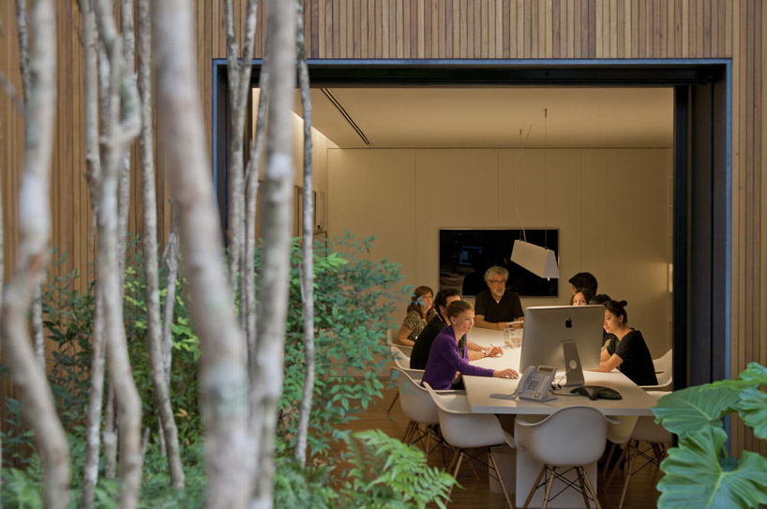
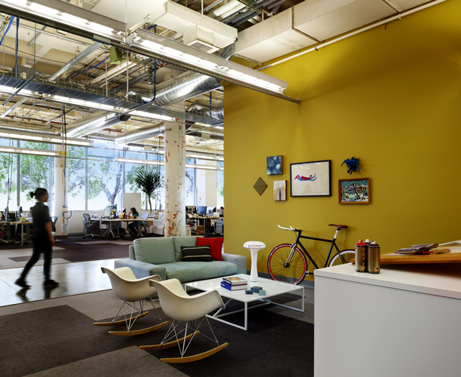
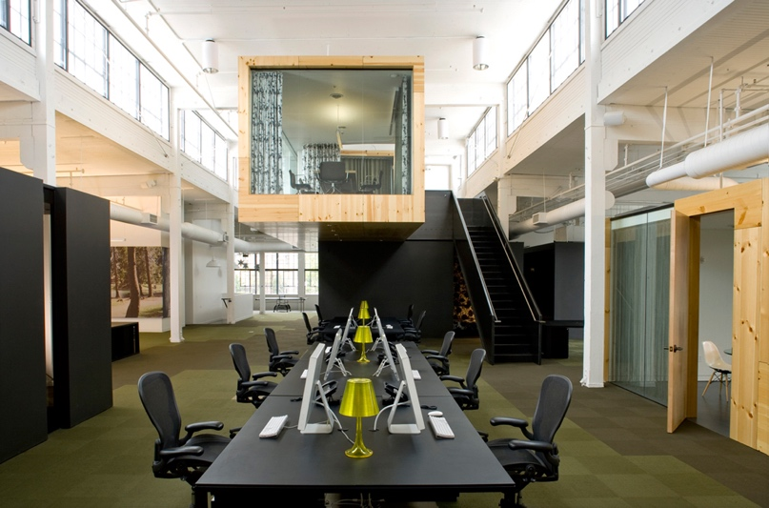
Startups need inspiring work environment
Visionary
Ahead of his time
Inspire trust for international partners
Anticipate urban and environmental challenges
© The Faktory - Company Belinvest SA

Slide 9
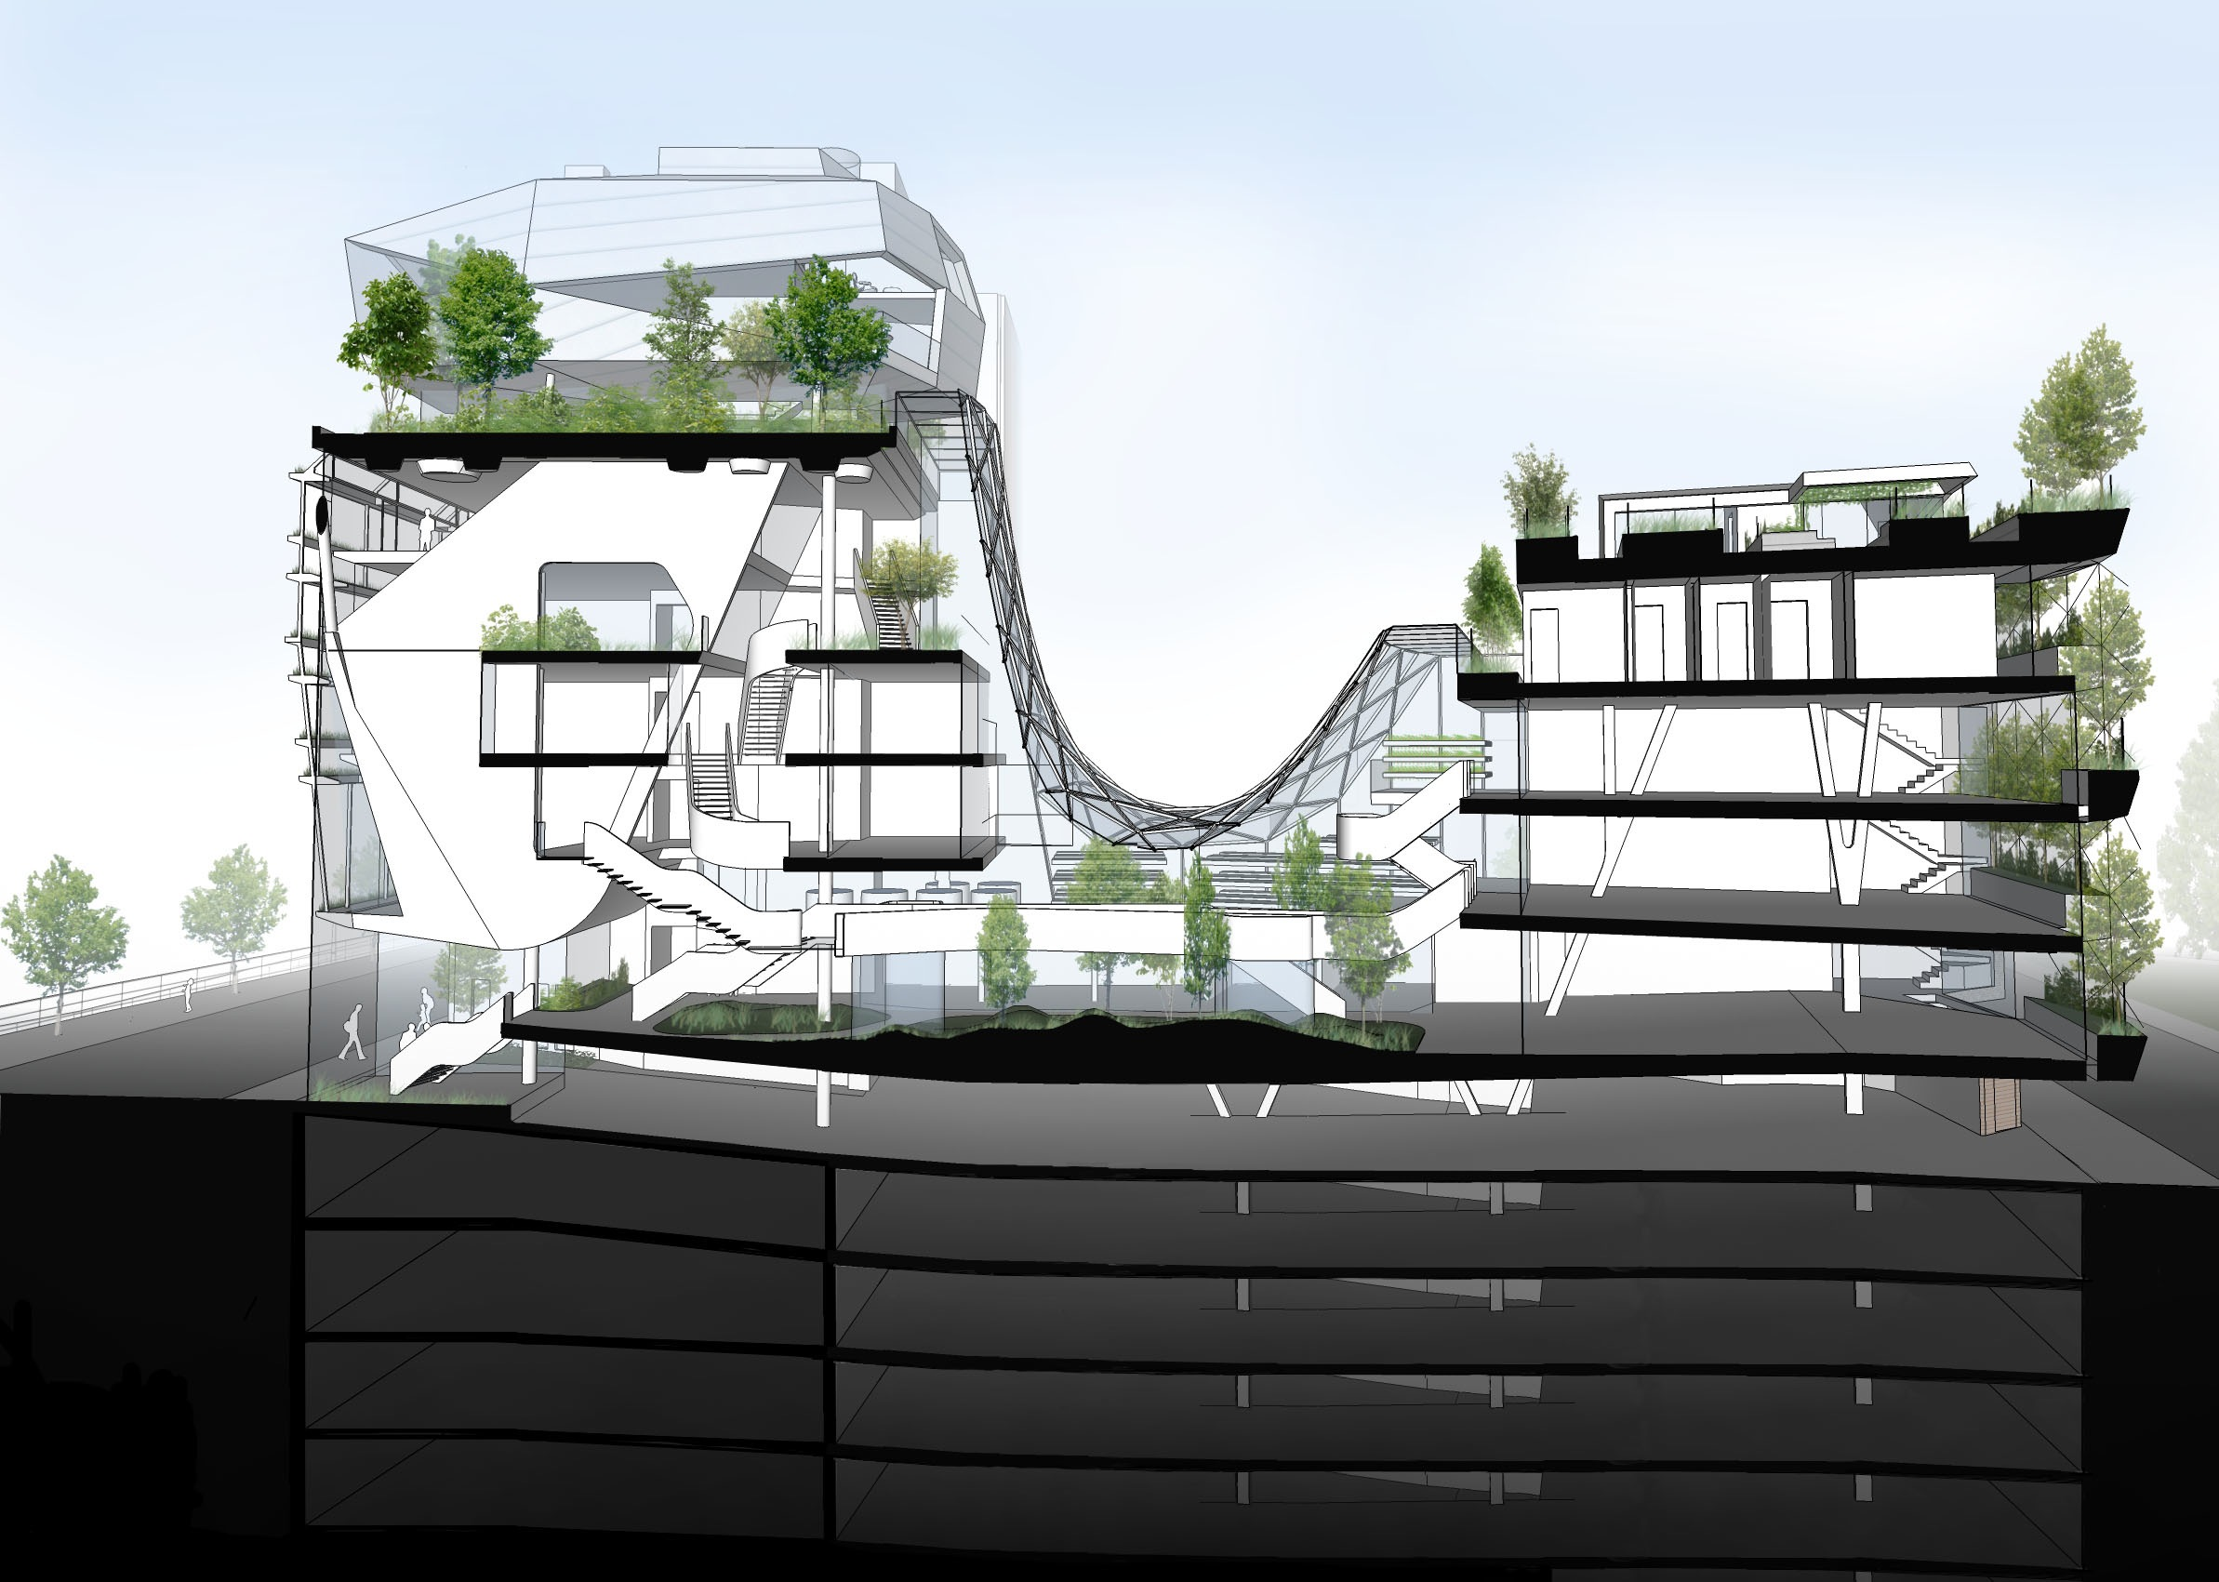
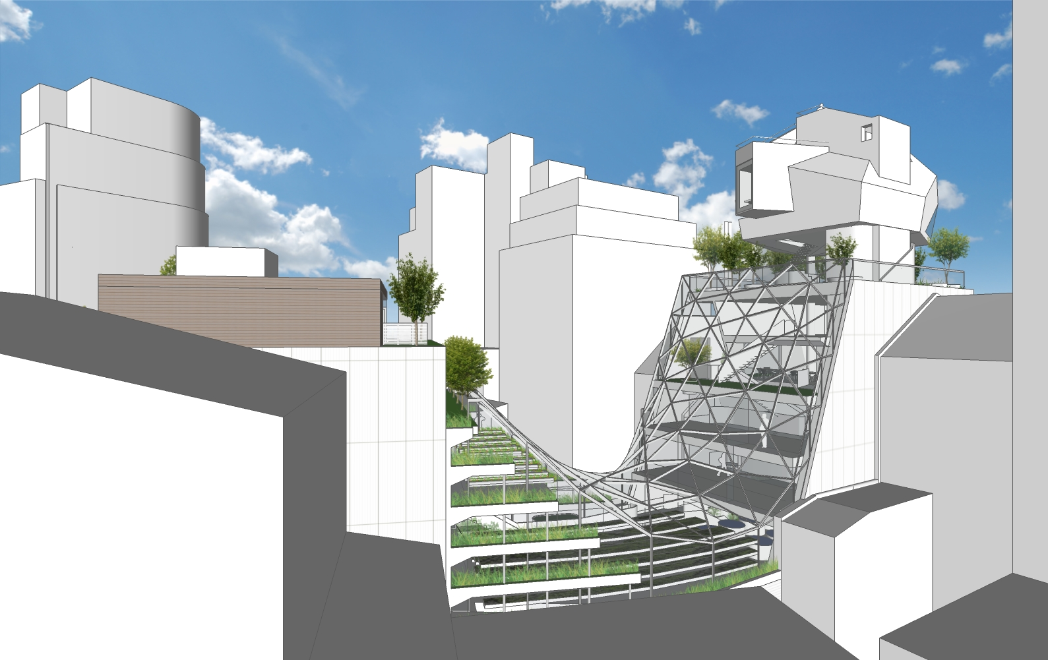

Marcellis 35 – The Faktory HQ
Our partners:
© The Faktory - Company Belinvest SA

Slide 10

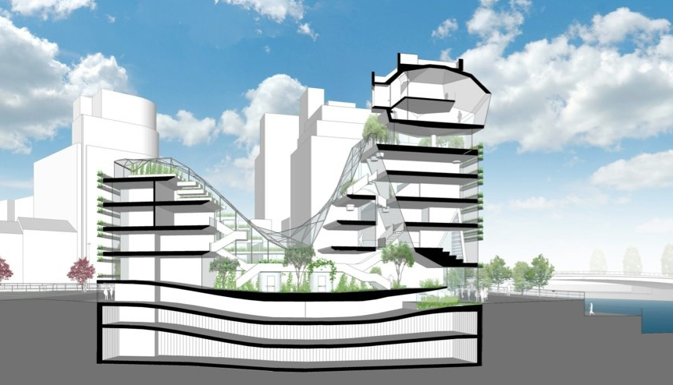

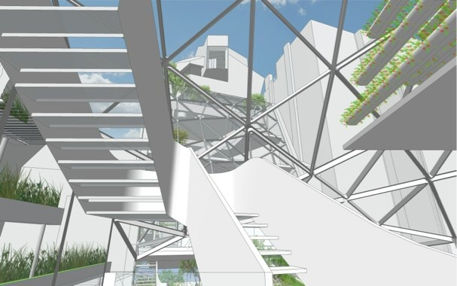
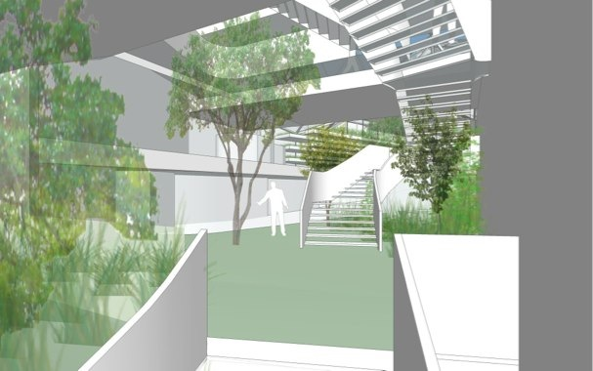
By 2017… New facilities
The Faktory will move to the city center of Liège
New green building that will mix urban agriculture, housing and offices
Unique and fresh work environment
Place where Art & Human Sciences will meet Technology
© The Faktory - Company Belinvest SA

Slide 11
© The Faktory - Company Belinvest SA

Slide 12
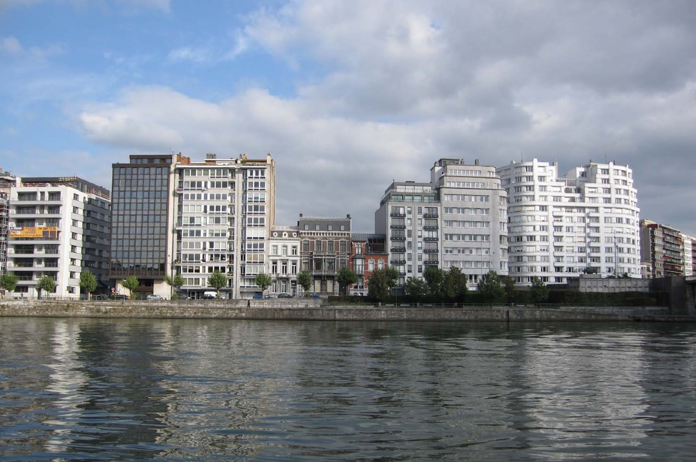
© The Faktory - Company Belinvest SA

Slide 13
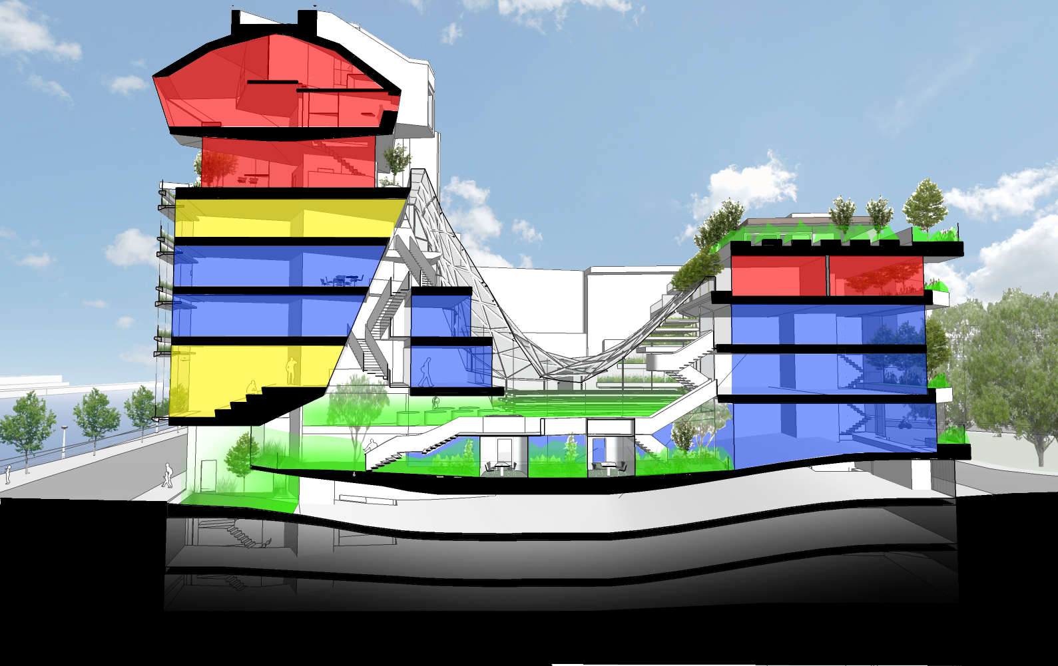
© The Faktory - Company Belinvest SA

Slide 14
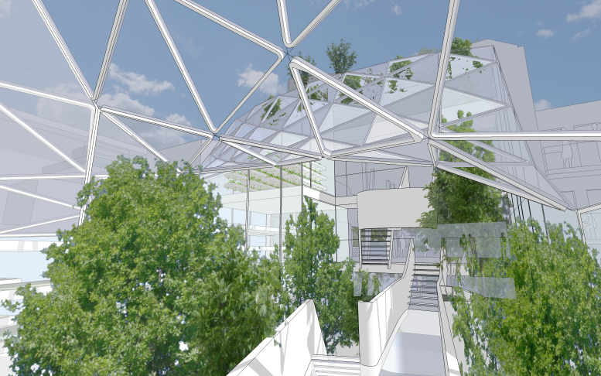
Ecosystems
Rythm of seasons
Nature and cooking
Integration of regional vegetal species
Partnership with the university of Liège/Gembloux
© The Faktory - Company Belinvest SA

Slide 15
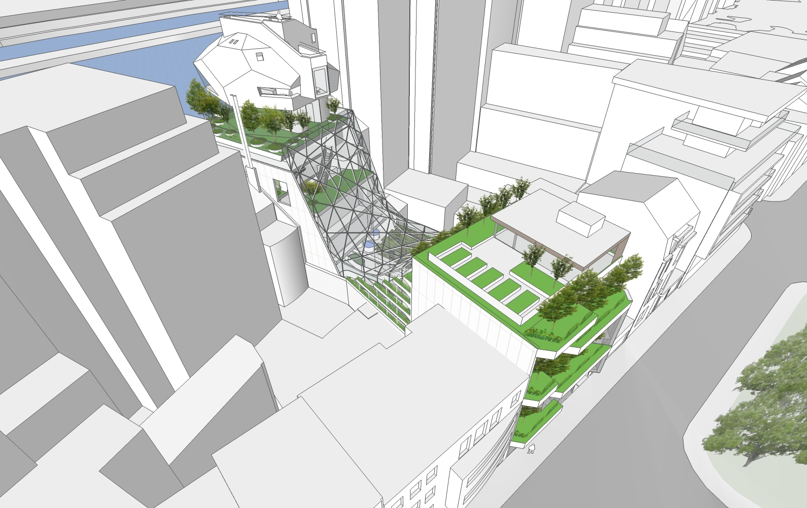
© The Faktory - Company Belinvest SA

Slide 16
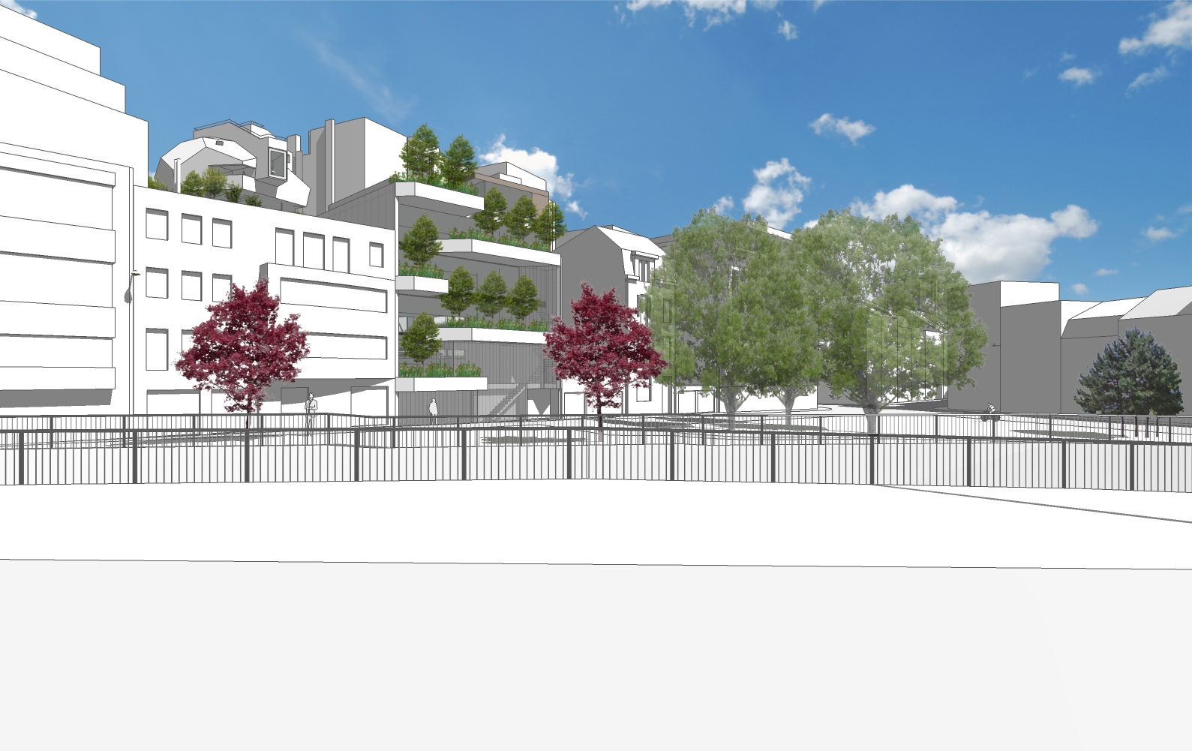
© The Faktory - Company Belinvest SA

Slide 17
Urban Farming
Prototyping & demonstration
Partnership with ULg
Aquapony
© The Faktory - Company Belinvest SA

Slide 18
Urban Farming
New models of food production and distribution
Relationship with neighborhood
Indoor and outdoor
© The Faktory - Company Belinvest SA

Slide 19
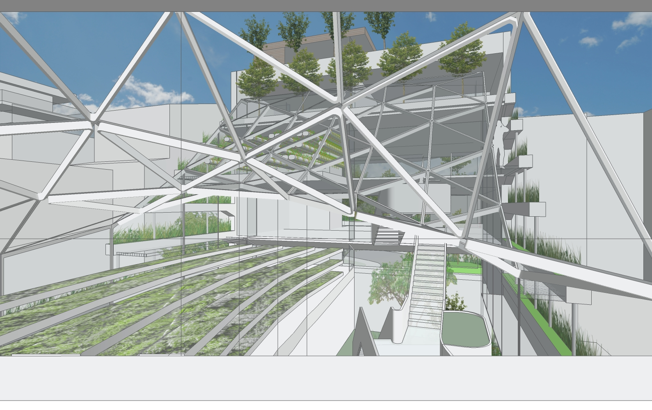
© The Faktory - Company Belinvest SA

Slide 20
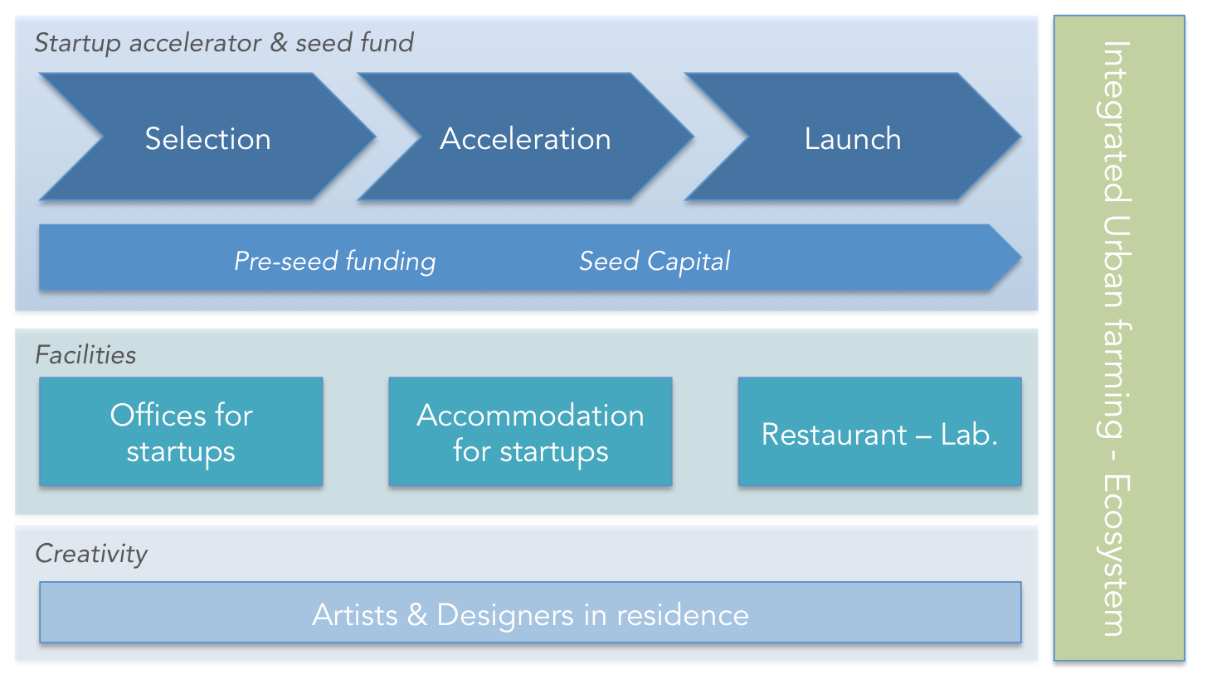
Summary
© The Faktory - Company Belinvest SA

Slide 21
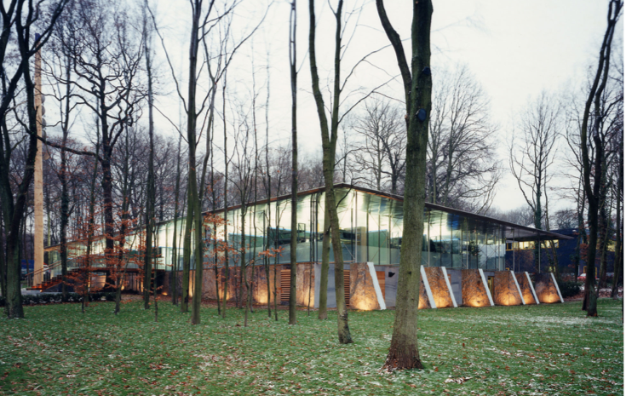
Contact us
Company The Faktory s.a.
  Rue Bois Saint-Jean, 16
  4102 Seraing – Belgium
  http://www.thefaktory.com
  simon.alexandre@thefaktory.com
  M.: +32 479 81 27 36
  Tw: @_TheFaktory

